Slide 1
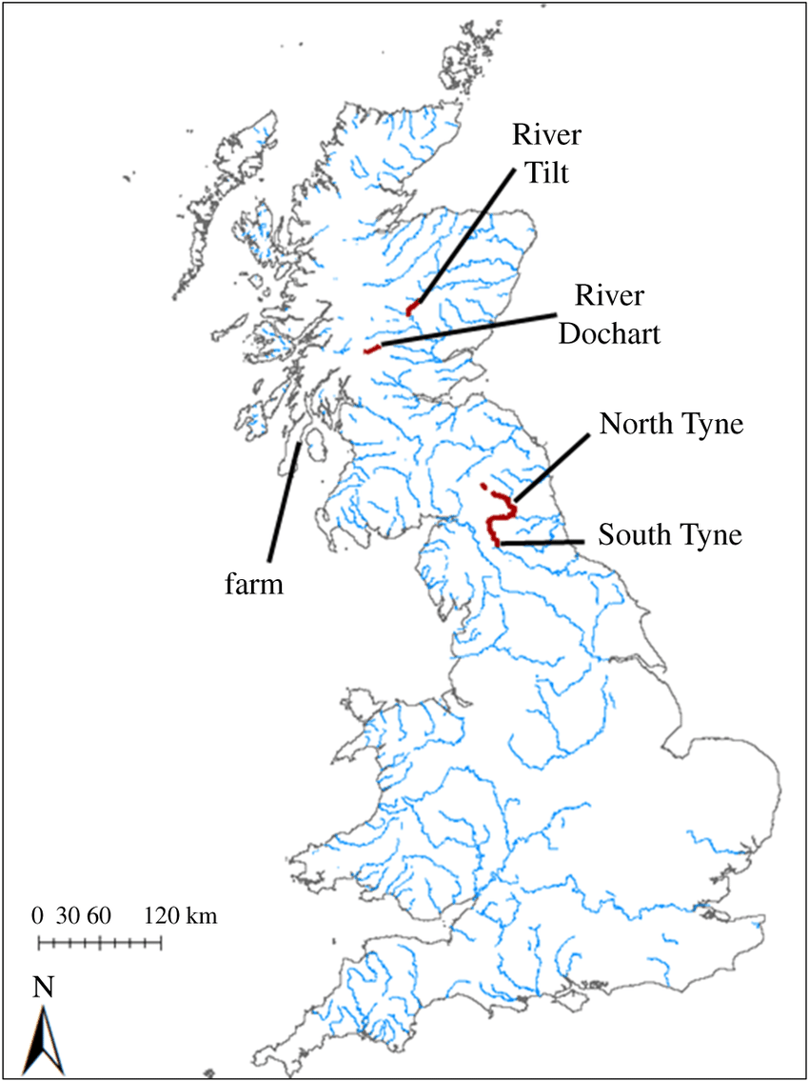
Vocabulary:
Stream- A stream is a small body of flowing water.
Delta- Deltas are often found at the mouth of large rivers.
Ox bow lake- Ox bow lakes are created when the meander is so deep that is cuts off a piece of the meander.
Tributary- When one stream meets another and merge together, the smaller stream is known as a tributary.
Deposition- rocks and sediments eroded from one part of the river is deposited in another part.
Erosion- erosion occurs when the fastest currents in the river carve intensely into the banks.
Waterfall- Waterfalls form where water rushes down steep hillsides in upland areas and erodes the rock.
Meander- A meander is a winding curve or bend in a river.
Source- The source of a river is where it begins, usually in high ground.
Mouth- A river mouth is the part of a river where the river flows into another river, a lake, a reservoir, a sea, or an ocean.
Estuary- An estuary is an area where a freshwater or stream meets the ocean.
Did you know?
Rivers carry water and nutrients to areas all around the earth. They play a very important part in the water cycle, acting as drainage channels for surface water. Rivers drain nearly 75% of the earth’s land surface. Rivers provide excellent transport links for towns and cities.
Thames London river that is 184 miles long
Seven Britain’s longest river (220 miles) from Wales to Bristol
Mersey Liverpool river that is 70 miles long
Geography: Rivers
Amazon Situated in Brazil, it’s 4000 miles long. Runs through the Amazon rainforest.
Nile The world’s longest river (4.160 miles long) and runs into the Mediterranean
Key points:
The source of a river is where it begins, usually in high ground.
A meander is a winding curve or bend in a river.
Ox bow lakes are created when the meander is so deep that is cuts off a piece of the meander.
The river Nile is the world’s longest river and runs into the Mediterranean.
The Amazon River is situated in Brazil and runs through the Amazon Rainforest.
Erosion has helped to form many interesting features of the Earth’s surface including mountain peaks, valleys, and coastlines.
Deposition is when the materials from erosion are dropped in a new location.

Slide 2
Vocabulary:
Thousands
Hundreds
Tens
Ones
Zero
Place value
Greater than
Less than
Order
Round
Rounded to
Negative number
Partition
Digit
Roman numeral
Maths: Place Value
4324 > 3243
Greater than

Slide 3
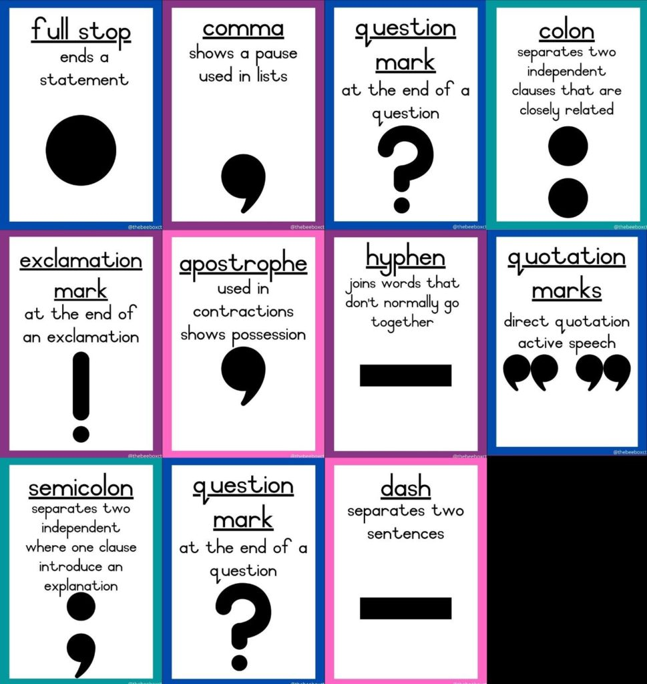
Writing:
Gorilla
By Anthony Brown

Slide 4
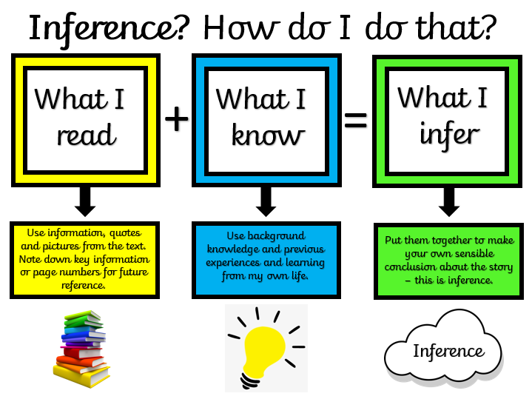
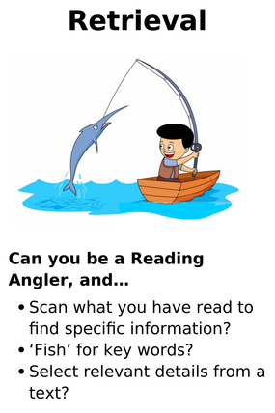
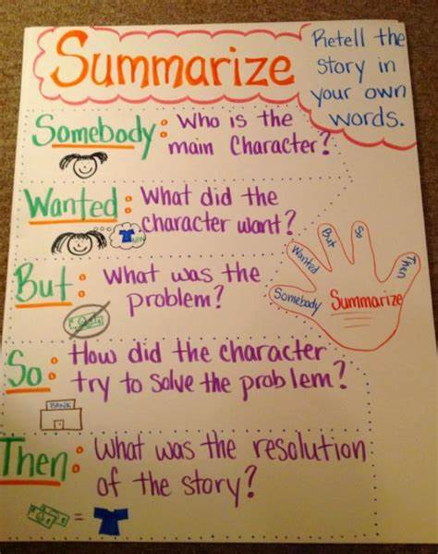
Reading
Skills

Slide 5
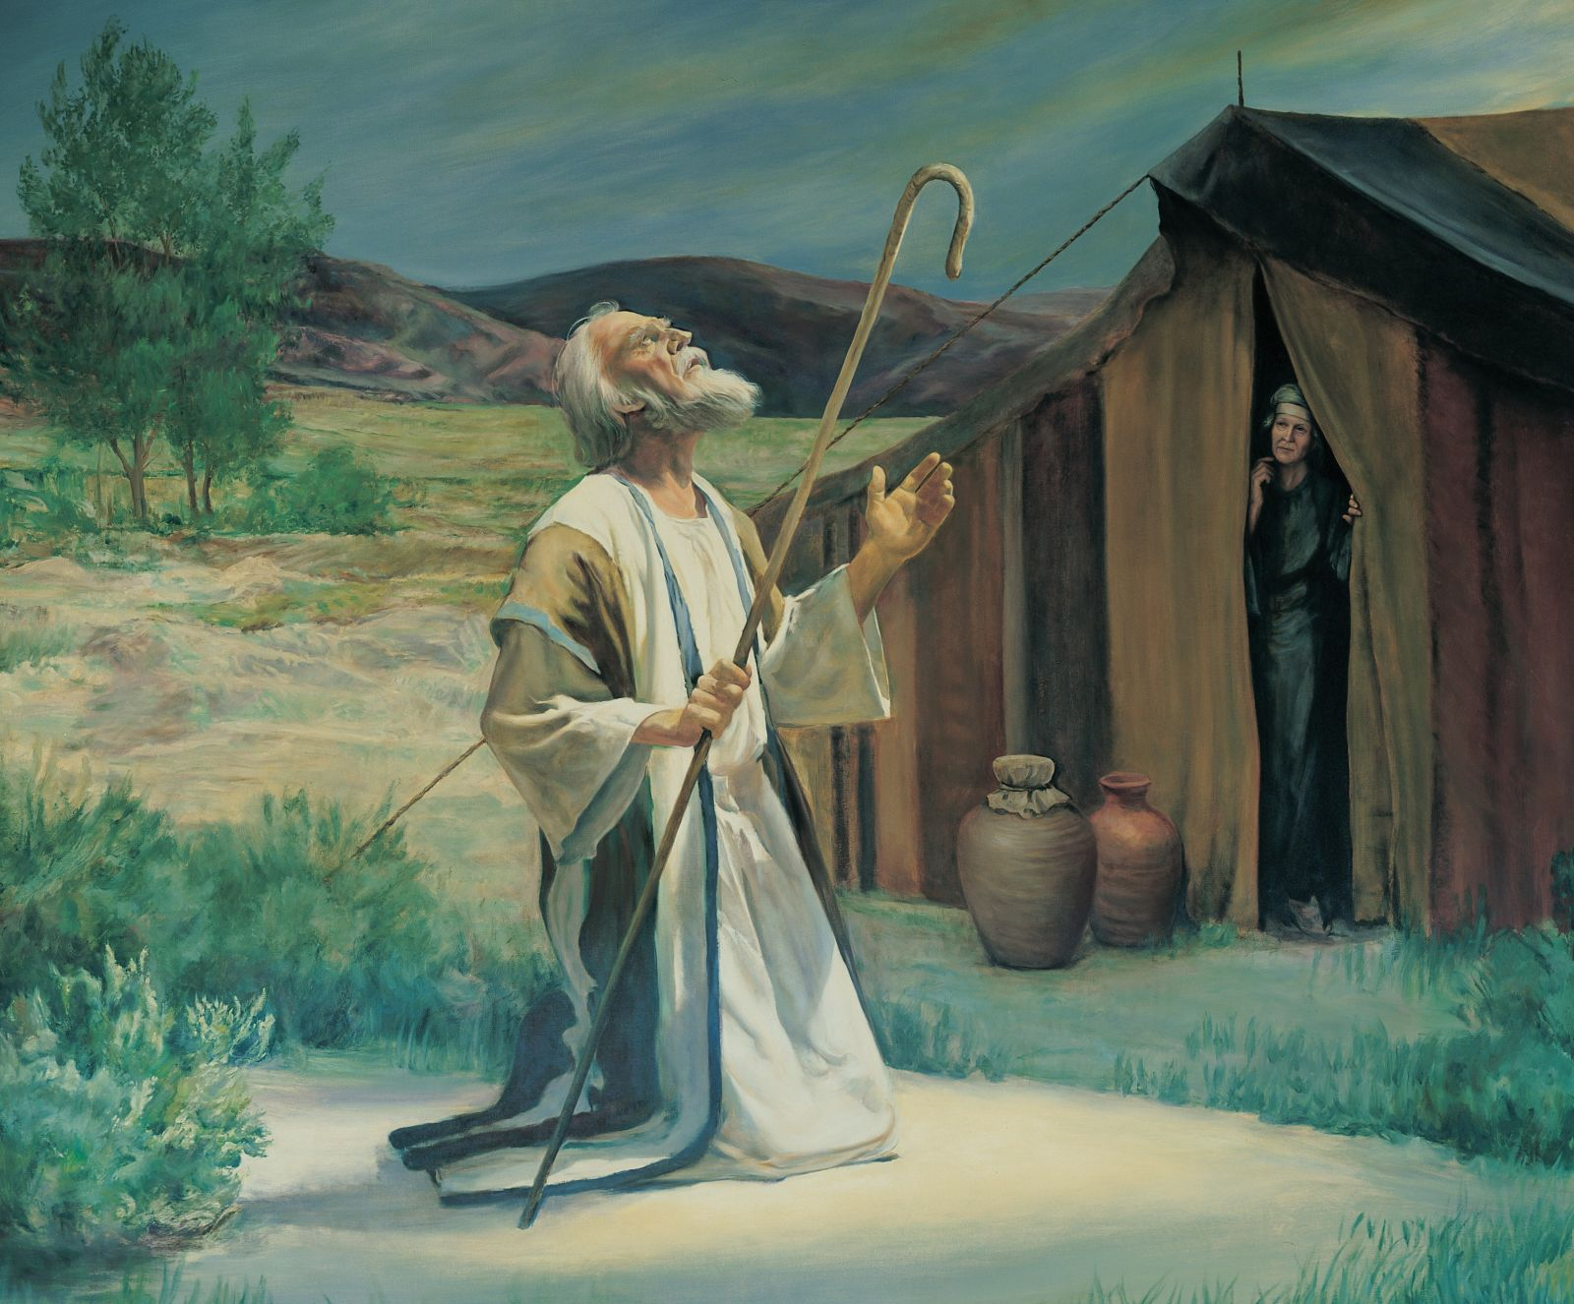
R.E.
Creation of Covenant
Genesis 12: 1-5
Now the Lord said to Abram, ‘Go from your country and your kindred and your father’s house to the land that I will show you. ² I will make of you a great nation, and I will bless you, and make your name great, so that you will be a blessing. ³ I will bless those who bless you, and the one who curses you I will curse; and in you all the families of the earth shall be blessed.
⁴ So Abram went, as the Lord had told him; and Lot went with him. Abram was seventy-five years old when he departed from Haran. ⁵ Abram took his wife Sarai and his brother’s son Lot, and all the possessions that they had gathered, and the persons whom they had acquired in Haran; and they set forth to go to the land of Canaan.

Slide 6
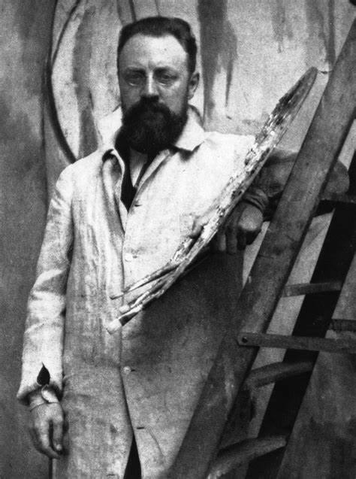
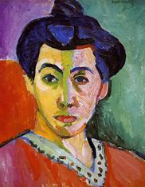
Draw your design on the polystyrene block, pressing in with the pencil
Don’t press too hard!
Apply ink or paint to the block
Press the block ink-side down to print it
Art:
Power prints
Henri Matisse
Painted with bold shapes and colours in the ‘Fauvist’ style.
Made paper cut-outs when he could no longer stand up to paint.
He called his collage style ‘painting with scissors.

Slide 7
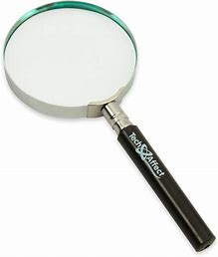
Science:
Biology Animals

